Slide 1
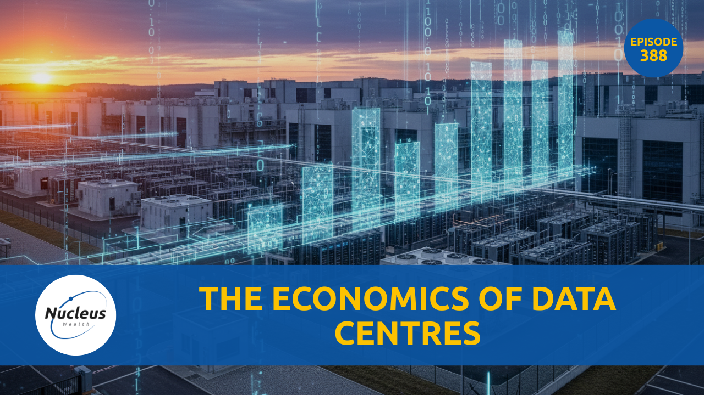
Podcast Visual to be inserted

Slide 2
Disclaimer:
The information provided on this presentation is general in nature and does not constitute personal financial advice. The information has been prepared without taking into account your personal objectives, financial situation or needs. Because of this, you should consider the appropriateness of the information for your own objectives, financial situation and needs before acting on it. Also, before you decide to invest in a financial product arranged by a representative of Nucleus Wealth Management Pty Ltd, ABN 54 614 386 266, corporate authorised representative of Nucleus Advice Pty Ltd AFSL 515796 (Nucleus Wealth or we or us), it is important that you read and consider the Product Disclosure Statement relating to the product before making any decision about whether to invest in it. Your Nucleus Wealth adviser can help you with this decision if you would like them to do so.

Slide 3
Agenda:
Why AI flipped the datacentre playbook: from racks-per-hall to power-per-rack.
Cost anatomy: CPU-era vs GPU-era cost stacks: density, cooling, networking, PUE, capex vs opex.
Power realities: Grid vs on-site generation, PPAs, demand response/load shedding, water use, PUE targets.
Chip economics: $/GPU-hour vs $/job; how perf/W gains lower total energy per training/inference even as TDP rises. Specialisation in chips.
Build vs rent: Buying NVIDIA racks vs renting capacity: utilisation, pricing models, payback math, financing risk.
Who’s buying: Big Tech, AI-native labs, enterprises (finance/health/auto/media), government; rough demand split.
Investment Universe
Investment Implications

Slide 4
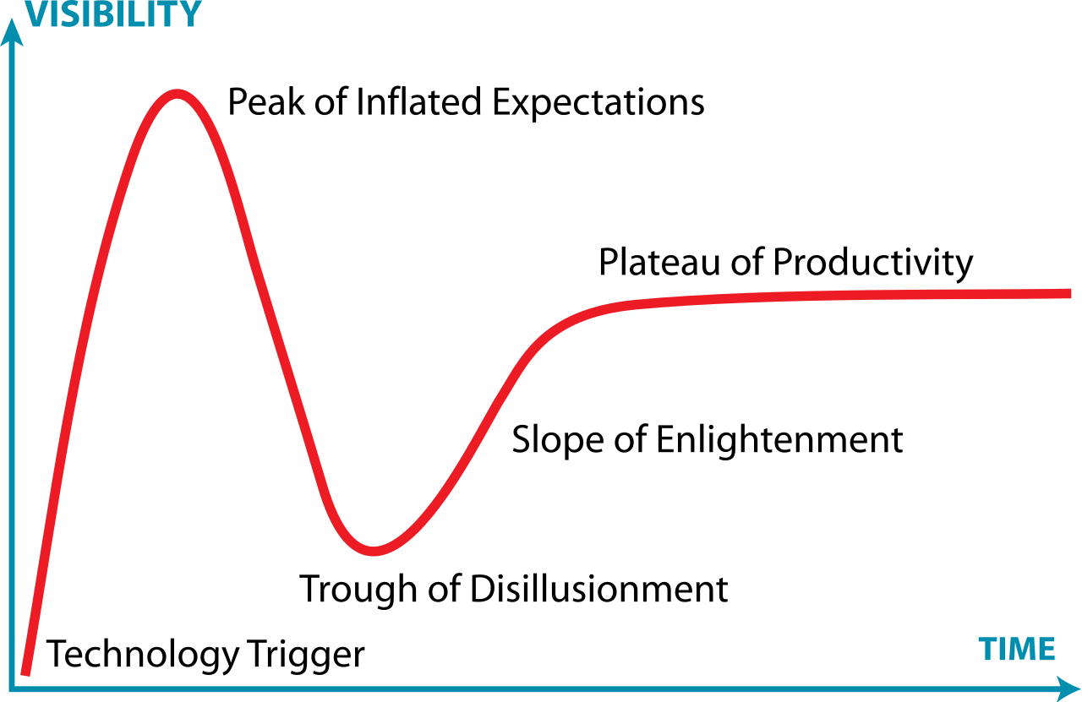
Agenda:

Slide 5

Bubble phase: Ouroboros
Notes:
One company reported a $400b increase in “booked revenue” from another company that makes $10b in sales per quarter and is losing money. And is a non-profit, unclear about legalities of raising money. And the first company will be going into debt to build the assets to service the 2nd company. A 3rd company looks like lending $100b to the 2nd company which will help. The first company will likely buy around 100b from the 3rd company. The 3rd company sells chips the the 2nd, but also buys services from it.

Slide 6
Change in Progress
Pre 1980s technology progress
Government (military)
Business
Consumer
Post 2000s technology progress
Government (military)
Business
Consumer
AI technology progress???
Government (military)
Business
Consumer

Slide 7
Costs: Things are still changing really, really quickly
DeepSeek 670B.
July 2025 cost to train = $4.5m
Dec 2025 expected cost = $2.5m

Slide 8
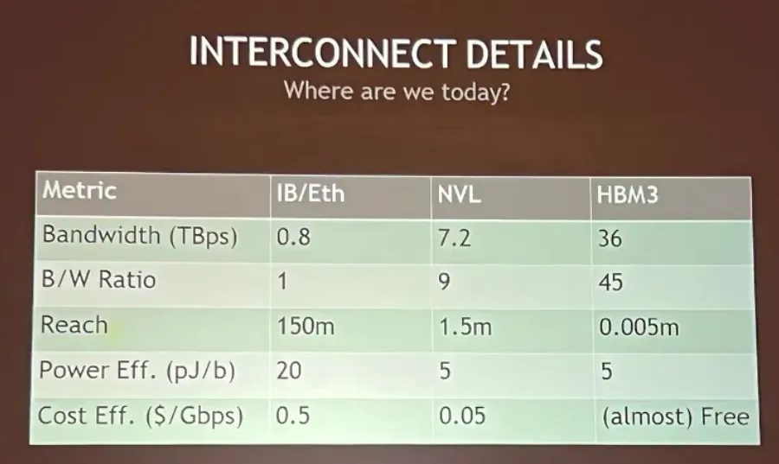
CPU -> GPU:

Slide 9
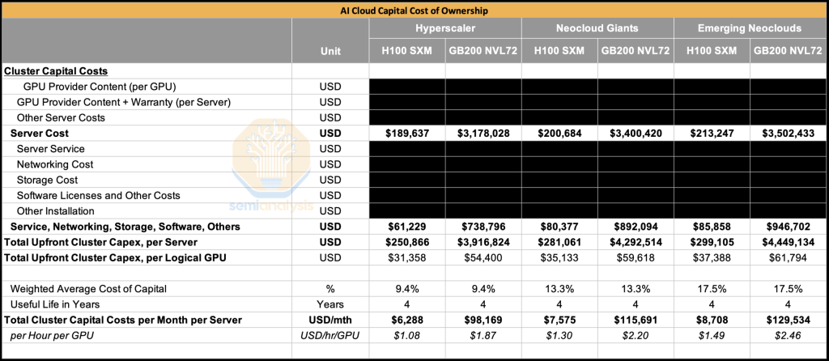
Costs: Capital

Slide 10
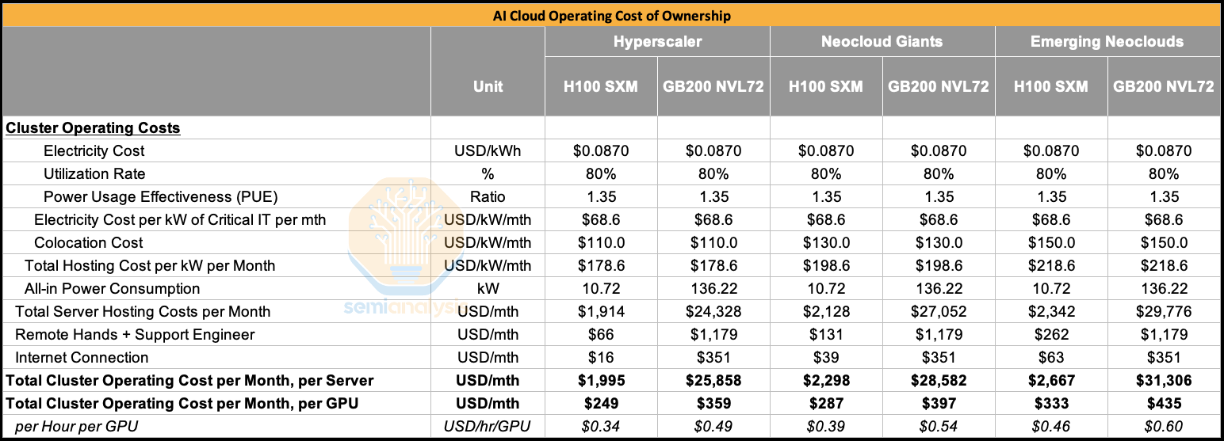
Costs: Opex

Slide 11
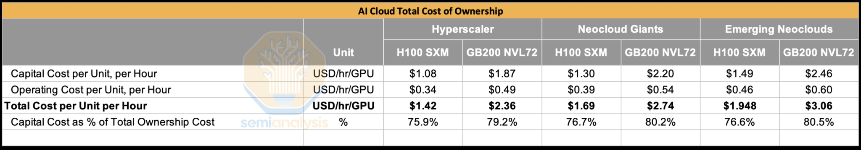
Total Costs
Electricity ~5%
Protectionism (tariffs, subsidies, “Buy American/European” policies) is likely to grow as Chinese cars become more competitive.

Slide 12
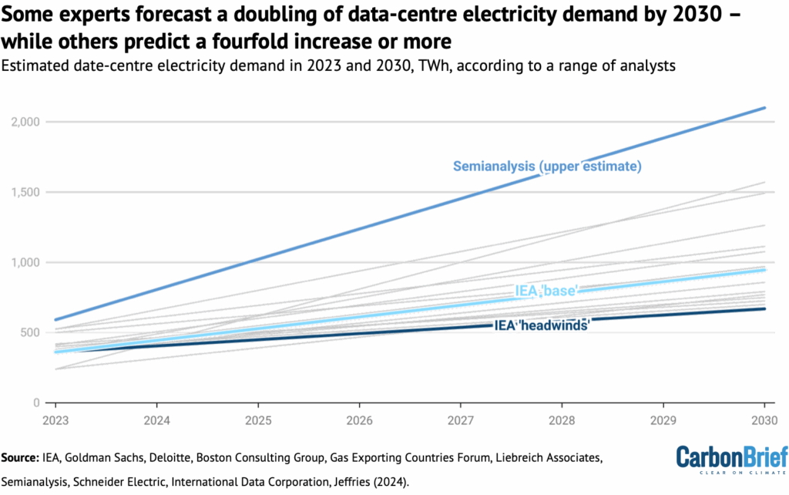
Power

Slide 13
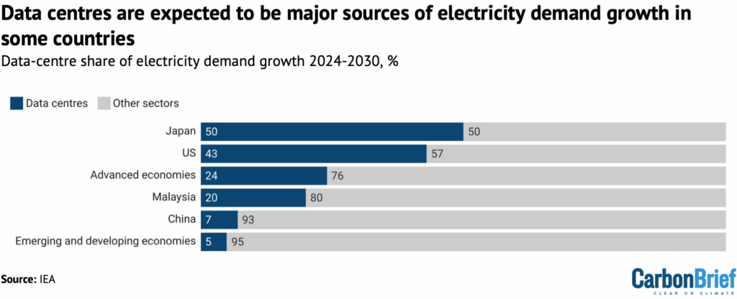
Power

Slide 14
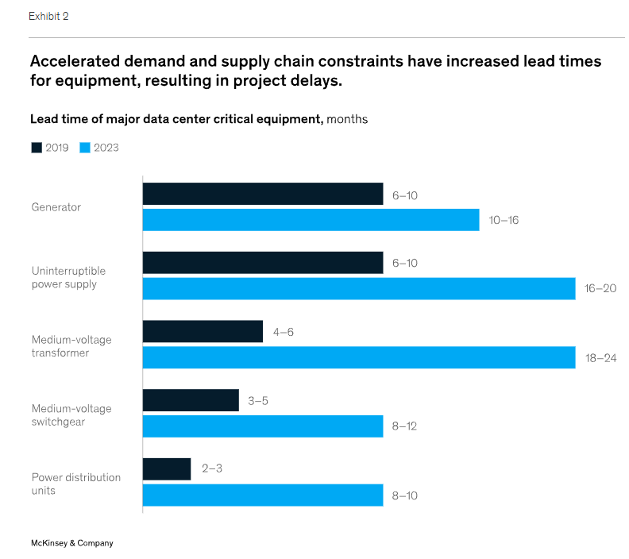
Power

Slide 15
Power
High level of need it is the issue. Much more power needed per rack. Need racks near each other.
Power (x2) + UPS + generators.
Scarce resources. Note pricing difference between short term scarcity and long term demand.
Do you build your own power? Probably not, level of redundancy. But part of the power highly likely. Batteries big, solar maybe.
Load shedding, possible. Probably not.
More power efficient chips? More efficient /compute, not less

Slide 16
Power
Datacentres have backups. Can help the grid
Higher willingness to pay. Small overall input.
Less benefit from efficiency. Lightbulb example
Staffing? Harder to move. US has big advantages.

Slide 17
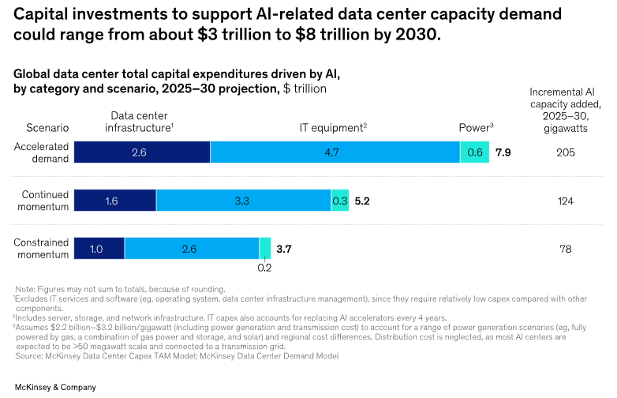
Power

Slide 18
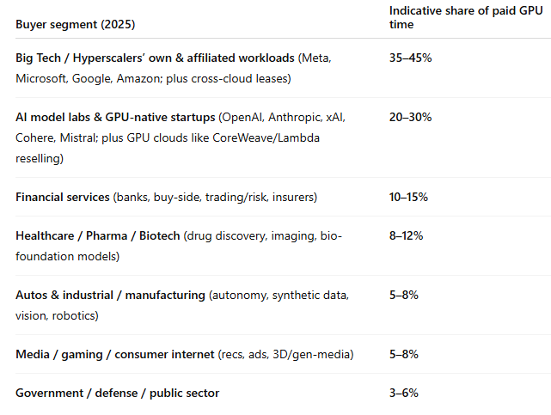
Who is buying?

Slide 19
Investment Universe — players & segments
Builders: real estate developers, design firms, and construction companies
Energizers: companies that supply the electricity and cooling systems
Technology developers and designers: semiconductor companies that develop the chips powering AI workloads
Operators: cloud providers and co-location firms that own and run large-scale data centers, such as Amazon Web Services, Google Cloud, and Equinix
AI architects: companies developing AI models and infrastructure, including OpenAI and Anthropic

Slide 20
Investment Outlook
Hyperscalers:
Microsoft leading the way, OpenAI? Reliance on others
Google in 3rd. Tensor chips interesting
AWS 2nd. Underperforming. But really interesting Trainium chips built with Anthropic.
Oracle. Not competing with customers. Could be biggest? Interesting tech. Most expensive, most risky.

Slide 21
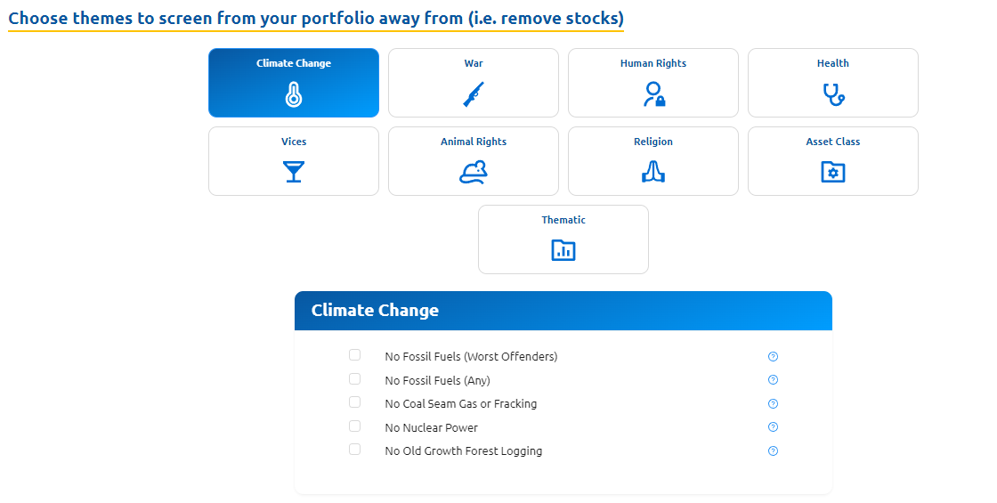

Slide 22
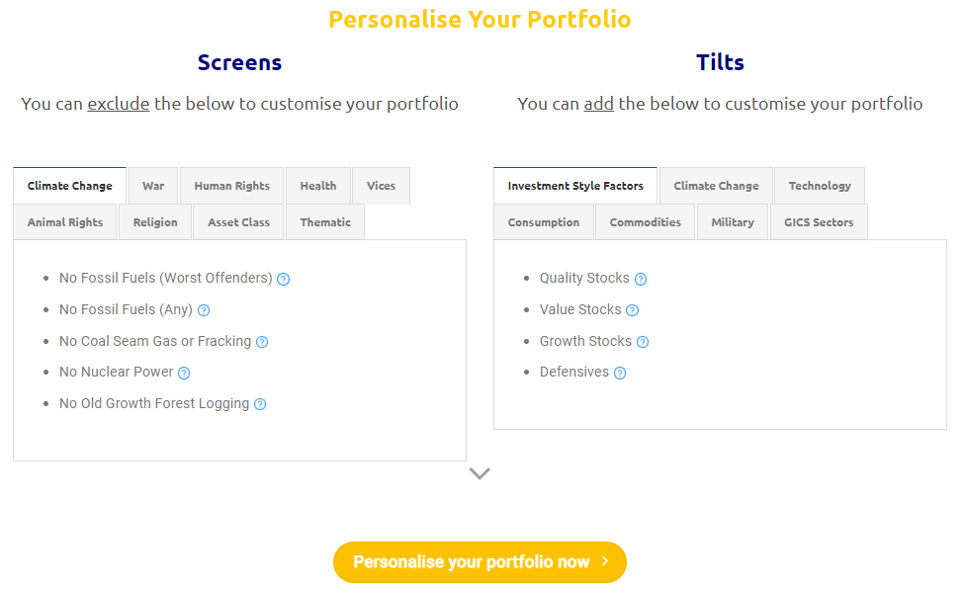

Slide 23
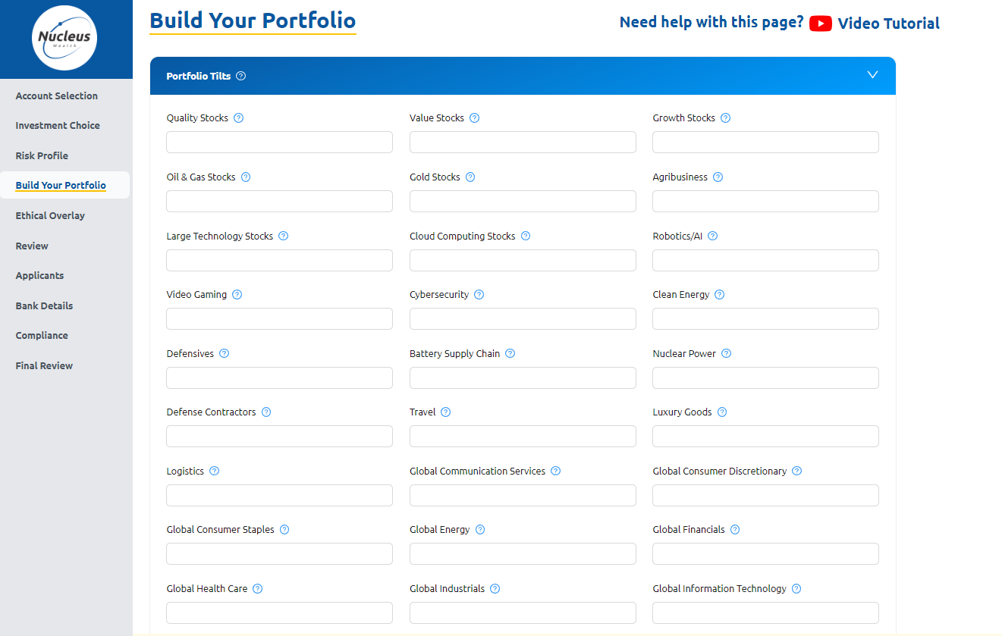

Slide 24







More from Nucleus Wealth:
Content: Nucleuswealth.com/content
Have a guest or topic suggestion for the show?
Leave a comment on YouTube
Social media:
Facebook.com/nucleuswealth
Find us on all major (and minor) podcast platforms:
Linkedin.com/company/nucleuswealth
Instagram.com/nucleus_wealth
Twitter.com/nucleuswealth

