Slide 2
Agenda
Russian default and fall out
Financial plumbing issues from removing Russia
Rising HY spreads globally and funding pressures
Chinese developers
Rising CDS prices, implications
Australian funding availability, cost of bank debt
Leverage and hedge funds
Effect of interest rates on house prices

Slide 3
How high can interest rates rise before defaults jump in Australia?

Slide 4
Investment Outlook
Rising rates, probability of Fed error
Supply chain issues not going away. Raising rates to bring demand down to level of supply. When will it clear.
China developers still major risk to commodities
Ukraine/Russia sanctions increase chance of left field event
Valuations expensive, not as bad as before. Way too high if earnings start declining

Slide 6
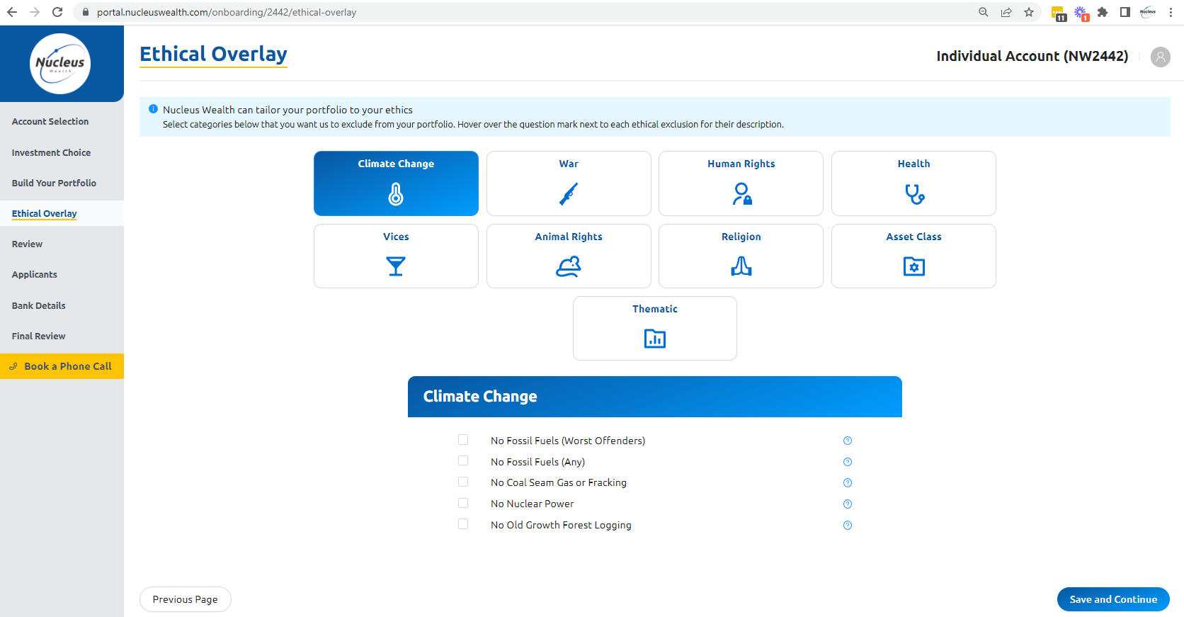

Slide 7
More from Nucleus Wealth:
Content: Nucleuswealth.com/content
Have a guest or topic suggestion for the show?
Leave a comment on YouTube
Social media:
Facebook.com/nucleuswealth
Find us on all major (and minor) podcast platforms:
Linkedin.com/company/nucleuswealth
Instagram.com/nucleus_wealth
Twitter.com/nucleuswealth

